Slide 1
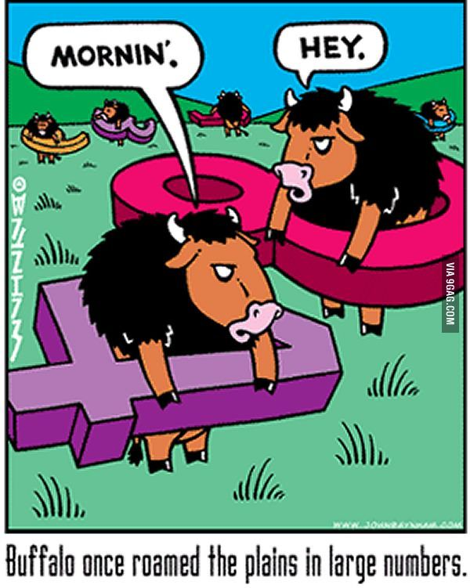
Asymptotic Analysis
CLRS, Sections 3.1 – 3.2

Slide 2
Asymptotic Complexity
Running time of an algorithm as a function of input size n, for large n.
Expressed using only the highest-order term in the expression for the exact running time.
Describes behavior of function in the limit.
Written using Asymptotic Notation.
CS 321 - Data Structures

Slide 3
Asymptotic Notation
Θ, O, Ω, o, ω
Defined for functions over the natural numbers.
  Ex: f(n) = Θ(n²).
    Describes how f(n) grows in comparison to n².
Defines a set of functions; in practice used to compare growth rate of two functions.
The notations describe the relationship between the defining function and a defined set of functions.
CS 321 - Data Structures

Slide 4

O-notation
For function g(n), we define O(g(n)), big-O of n, as the set:
O(g(n)) = {f(n) :
∃ positive constants c and n_{0,} such that ∀n ≥ n₀,we have 0 ≤ f(n) ≤ cg(n) }
Intuitively: Set of all functions whose rate of growth is the same as or lower than that of g(n).
g(n) is an asymptotic upper bound for f(n).
f(n) = Θ(g(n)) ⇒ f(n) = O(g(n))
Θ(g(n)) ⊂ O(g(n))
CS 321 - Data Structures

Slide 5

Ω -notation
For function g(n), we define Ω(g(n)), big-Omega of n, as the set:
Ω(g(n)) = {f(n) :
∃ positive constants c and n_{0,} such that ∀n ≥ n₀,
we have 0 ≤ cg(n) ≤ f(n)}
Intuitively: Set of all functions whose rate of growth is the same as or higher than that of g(n).
g(n) is an asymptotic lower bound for f(n).
f(n) = Θ(g(n)) ⇒ f(n) = Ω(g(n))
Θ(g(n)) ⊂ Ω(g(n))
CS 321 - Data Structures

Slide 6

Θ-notation
For function g(n), we define Θ(g(n)), big-Theta of n, as the set:
Θ(g(n)) = {f(n) :
∃ positive constants c₁, c₂, and n_{0,}
such that ∀n ≥ n₀, we have 0 ≤ c₁g(n) ≤ f(n) ≤ c₂g(n)}
Intuitively: Set of all functions that
have the same rate of growth as g(n).
g(n) is an asymptotically tight bound for f(n).
CS 321 - Data Structures

Slide 7
Relationship Between Θ, O, Ω
CS 321 - Data Structures

Slide 8
Relationship Between Θ, Ω, O
Theorem : For any two functions g(n) and f(n),
f(n) = Θ(g(n)) iff
f(n) = O(g(n)) and f(n) = Ω(g(n)).
Θ(g(n)) = O(g(n)) ∩ Ω(g(n))
In practice, asymptotically tight bounds are obtained from asymptotic upper and lower bounds.
CS 321 - Data Structures

Slide 9
o-notation
For a given function g(n), the set little-o:
o(g(n)) = {f(n): ∀ c > 0, ∃ n₀ > 0 such that ∀ n ≥ n₀, we have 0 ≤ f(n) < cg(n)}.
Intuitively: Set of all functions whose rate of growth is lower than that of g(n).
g(n) is an upper bound for f(n)that is not asymptotically tight.
CS 321 - Data Structures

Slide 10
ω -notation
For a given function g(n), the set little-omega:
ω(g(n)) = {f(n): ∀ c > 0, ∃ n₀ > 0 such that ∀ n ≥ n₀, we have 0 ≤ cg(n) < f(n)}.
Intuitively: Set of all functions whose rate of growth is higher than that of g(n).
g(n) is a lower bound for f(n) that is not asymptotically tight.
CS 321 - Data Structures

Slide 11
Comparison of Functions
f ↔ g ~ a ↔ b
f (n) = O(g(n)) ~ a ≤ b
f (n) = Ω(g(n)) ~ a ≥ b
f (n) = Θ(g(n)) ~ a = b
f (n) = o(g(n)) ~ a < b
f (n) = ω(g(n)) ~ a > b
CS 321 - Data Structures

Slide 12
Limit Definitions of Asymptotic Notations
o-notation (little-o):
  f(n) becomes insignificant relative to g(n) as n approaches infinity:
lim [f(n) / g(n)] = 0
^{n→∞}
ω -notation (little-omega):
  f(n) becomes arbitrarily large relative to g(n) as n approaches infinity:
lim [f(n) / g(n)] = ∞
^{n→∞}
CS 321 - Data Structures

Slide 13
Limit Definitions of Asymptotic Notations
Θ-notation (Big-theta):
  f(n) relative to g(n)equals a constant, c, which is greater than 0 and less than infinity as n approaches infinity:
0 < lim [f(n) / g(n)] < ∞
^{n→∞}
CS 321 - Data Structures

Slide 14
Limit Definitions of Asymptotic Notations
O-notation (Big-o):
  f(n) ∈ O(g(n)) ⇒ f(n) ∈ Θ(g(n))and f(n) ∈ o(g(n))
  f(n) relative to g(n)equals some value less than infinity as n approaches infinity:
lim [f(n) / g(n)] < ∞
^{n→∞}
Ω -notation (Big-omega):
  f(n) ∈ Ω(g(n)) ⇒ f(n) ∈ Θ(g(n))and f(n) ∈ ω(g(n))
  f(n) relative to g(n)equals some value greater than 0 as n approaches infinity:
0 < lim [f(n) / g(n)]
^{n→∞}
CS 321 - Data Structures

Slide 15
Examples
Use limit definitions to prove:
  10n - 3n ∈ O(n²)
  3n⁴ ∈ Ω(n³)
  n²/2 - 3n ∈ Θ(n²)
  2^{2n}∈ Θ(2^{n})
CS 321 - Data Structures

Slide 16
Examples
Use limit definitions to prove:
  10n - 3n ∈ O(n²) – Yes!
lim [ 10n - 3n / n² ] = 0
^{n→∞}
  3n⁴ ∈ Ω(n³) – Yes!
lim [ 3n⁴ / n³ ] = ∞
^{n→∞}
  n²/2 - 3n ∈ Θ(n²) – Yes!
lim [ n²/2 - 3n / n² ] = 1/2
^{n→∞}
  2^{2n}∈ Θ(2^{n}) – No!
lim [ 2^{2n} / 2^{n} ] = ∞
^{n→∞}
CS 321 - Data Structures

Slide 17
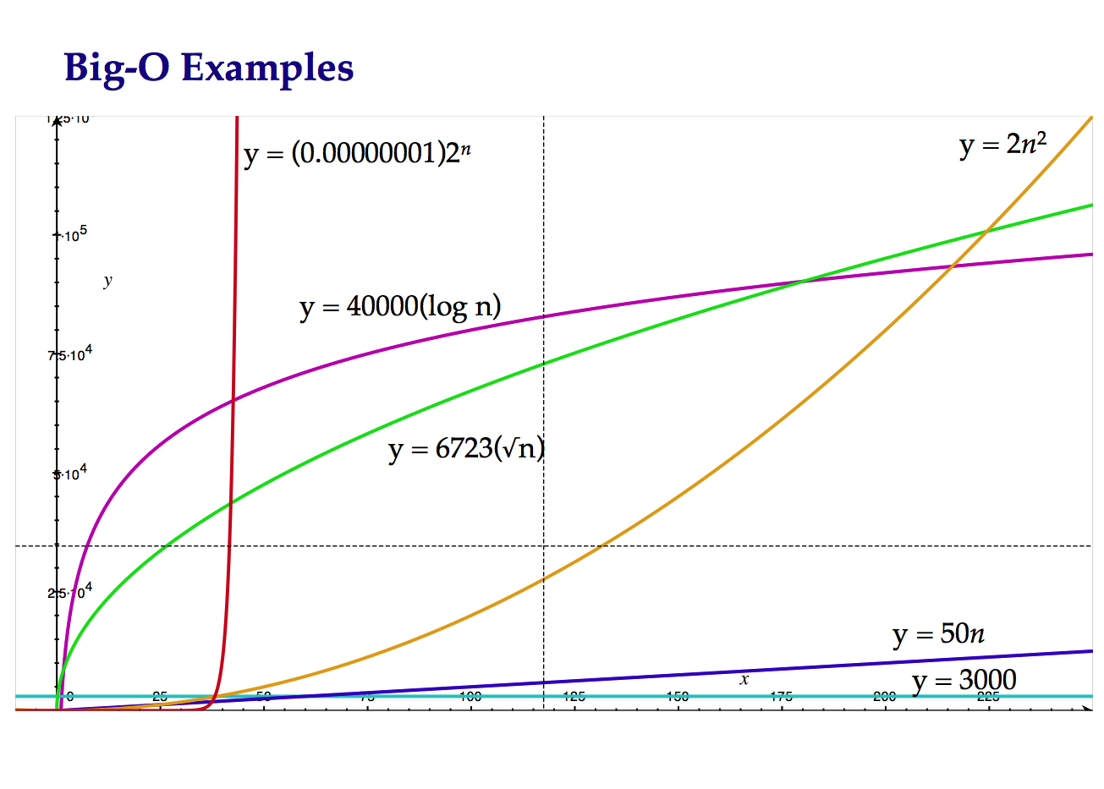
Why Do We Care?
CS 321 - Data Structures

Slide 18
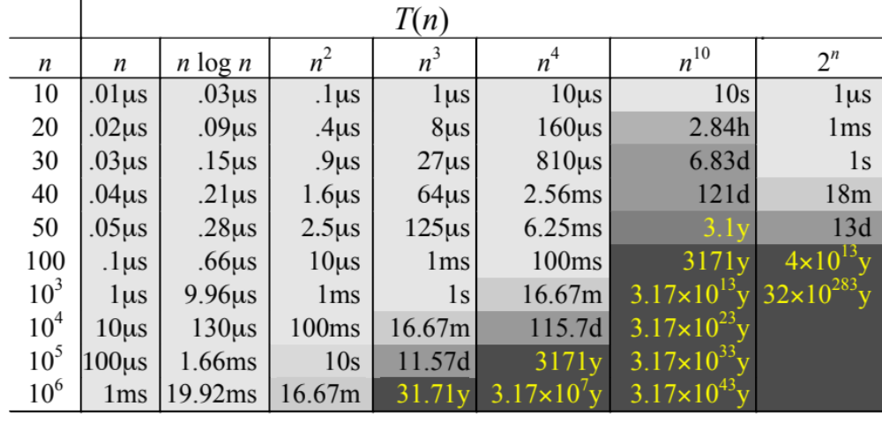
Complexity and Tractability
Assuming the microprocessor performs 1 billion ops/s.
CS 321 - Data Structures

Slide 19
CS 321 - Data Structures

